Slide 1

Chapter 9
Professional Ethics

Slide 2
Upcoming
Essay Check-in (extension?)
Exam: April 16th
1-<number>

Slide 3
Quiz 6 Review
Mature professions (examples)
Mature professions (characteristics)
Licensing
Software engineers vs. other professions
Institute that developed the software engineers’ code of ethics (SECE)
Principles of the SECE
Whistle-blowers (def.)
Challenger shuttle problem
Michael McFarland on teams of engineers
Paternalism and the Harm Principle
1-<number>

Slide 4
Censorship and the Harm Principle
Can someone’s free expression harm others? Is this the type of harm the harm principle is meant to protect against?

Slide 5
Social Rights
When someone contends that the harmful behaviour of others harms me socially. For example, allowing people to drink alcohol. (J.S. Mill opposed – too broad).

Slide 6
Paternalism
Roughly the interference with a person’s liberty of action justified by reasons referring exclusively to the welfare, good, happiness, needs, interests or values of the person being coerced” (Gerald Dworkin, Morality, Harm and the Law).

Slide 7
Soft vs. Hard Paternalism
Soft paternalism: paternalism is justified on the basis of informing people of the dangers/harms they face. But it allows them to face them so long as there is no other harm (e.g. cigarette labels). Seems to adhere to the core ideas behind the harm principle – according to JS Mill.
Hard paternalism: paternalism is justified even in some situations where a person knows the danger/harm, but wants to proceed anyways (e.g. healthcare).

Slide 8
Pure vs. Impure Paternalism
Pure Paternalism: only those people who are being protected have their liberty impeded. (e.g. laws requiring bike helmets)
Impure Paternalism: a wider class of people have restrictions put on their liberty. (e.g. cigarette manufacturers)

Slide 9
Moral Paternalism
“The usual justification for paternalism refers to the interests of the person being interfered with. These interests are defined in terms of the things that make a person’s life go better; in particular their physical and psychological condition. It is things like death or misery or painful emotional states which are in question. Sometimes, however, advocates of state intervention seek to protect the moral welfare of the person. So, for example, it may be argued that prostitutes are better off being prevented from plying their trade even if they make a decent living and their health is protected against disease. They are better off because it is morally corrupting to sell one’s sexual services. The interference is justified, therefore, to promote the moral well-being of the person. This then can be called moral paternalism” (G. Dworkin, Stanford Encyclopedia of Philosophy, 2017).

Slide 10
Ethics and Punishment
Social Contract Theory: Law must be prospective, positive, and promulgated/popularized.
Kant: Law’s purpose is to punish transgressors.
Utilitarianism: Law’s purpose is to improve society.

Slide 11
Utilitarian Reasons for Punishment
Retribution
Restore
Rehabilitate
Remove
Deter

Slide 12
Meta-Ethical Issues
Meta- ethics: the study of the different ways we do ethics.
  Ethical models are used to judge the world, but can we also use the world to judge ethical theories? What is the relationship between them?
  Is there a reward for being good?
  Is there an ethical cost to calling out ethics/keeping quiet about ethics?

Slide 13
Chapter Overview
Introduction
How well developed are the computing professions?
Software engineering code of ethics
Analysis of the code
Case studies
Whistle-blowing
9-2

Slide 14
9.1 Introduction
Informally, profession a vocation requiring…
  High level of education
  Practical experience
We pay professionals well
  Doctors
  Lawyers
We trust professionals to…
  Correctly ascertain and treat problems
  Take actions for the good of their clients
9-3

Slide 15
9.2 How Well Developed Are the Computing Professions?
9-4

Slide 16
Characteristics of a Profession
Initial professional education
Accreditation
Skills development
Certification
Licensing
Professional development
Code of ethics
Professional society
9-5

Slide 17
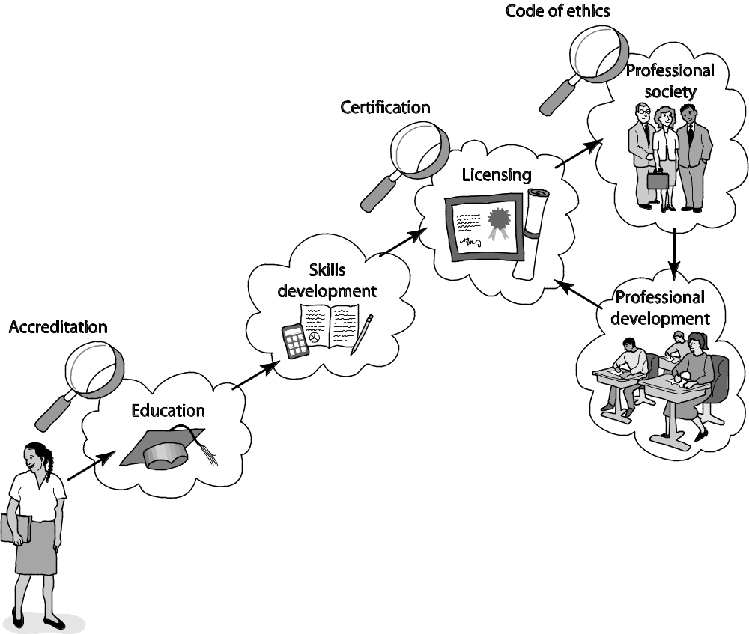
Attributes of a Mature Profession
9-6

Slide 18
Case Study: Certified Public Accountants
Bachelor’s degree
  150+ semester hours
  24+ hours of accounting-related classes
Two years’ experience working under supervision of a CPA
CPA exam
To retain certification
  Continuing education
  Follow code of ethics
9-7

Slide 19
How Do Computer-Related Careers Stack Up?
Certification and licensing not required
College degree not required
Apprenticeship not required
Membership in professional society optional
No specific requirements for continuing education
Most computer programmers, system analysts, etc. are part of teams
9-8

Slide 20
Status of Certification and Licensing
Software engineer: someone engaged in development or maintenance of software, or teaches in this area
Path to certification now exists: similar to path taken by engineers in other disciplines, such as civil engineering
  Four years of post-college work experience
  Pass Fundamentals of Engineering (FE) exam
  Pass discipline-specific Principles and Practice of Engineering (PE) exam
  PE exam in software available since 2013
Only a very small percentage of software engineers will have to be licensed
  Those developing software that can affect health, safety, and welfare of the public
  Those offering their services directly to the public
9-9

Slide 21
Ability to Harm Public
Many computer professionals hold responsibilities similar to those held by members of mature professions
Therac-25 killed or gravely injured at least six people
Millions rely upon software rather than accountants to prepare their tax returns
Millions of people rely on system administrators to keep their work-related information secure
9-10

Slide 22
The Importance of Taking Personal Responsibility
The ability to cause harm to members of the public is a powerful reason why those in computer-related careers must act according to ethical principles. Without universal certification and licensing and other components of a well-developed profession to rely upon, those in computer-related careers must take more personal responsibility for developing their ethical decision-making skills.
9-11

Slide 23
9.3 Software Engineering Code of Ethics
9-12

Slide 24
Preamble of Code
Software engineers have opportunities to do good or do harm
Software engineers ought to be committed to doing good
Eight principles identify key ethical relationships and obligations within these relationship
Code should be seen as a whole, not a collection of parts
Concern for the public interest is paramount
9-13

Slide 25
Eight Principles Identify Morally Responsible Relationships
Public
Client and employer
Product
Judgment
Management
Profession
Colleagues
Self
9-14

Slide 26
Act Consistently with Public Interest
1.01 “Accept full responsibility for own work”
1.02 Balance competing interests
1.03 Approve software only if it is safe
1.04 Disclose actual/potential dangers
1.05 “Cooperate in efforts to address” public concerns
1.06 “Be fair and avoid deception in all statements”
1.07 Consider factors that diminish access to software
1.08 “Volunteer professional skills to good causes”
9-15

Slide 27
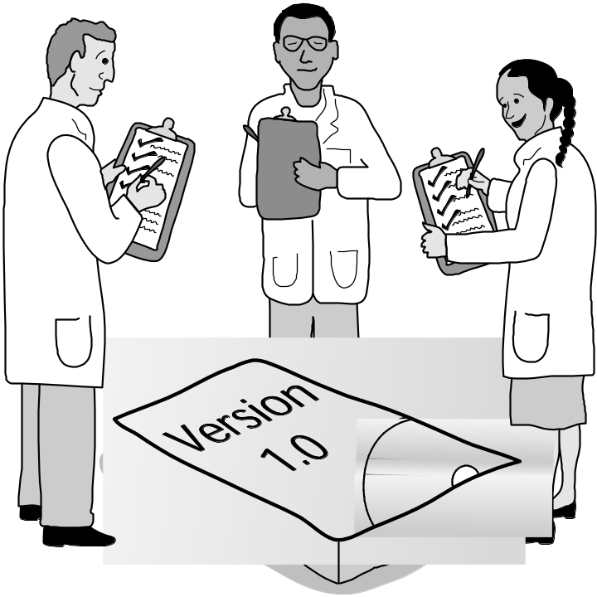
Clause 1.03
Approve Software Only If It Is Safe
9-16

Slide 28
Act in Best Interest of Client, Employer
2.01 Act within areas of competence
2.02 Don’t use software obtained illegally
2.03 Only use property in authorized ways
2.04 Ensure documents are approved
2.05 Respect confidentiality
2.06 Promptly report problems with project
2.07 Report issues of social concern
2.08 Refuse outside work detrimental to job
2.09 Put employer’s/client’s interests first, unless overriding moral concern
9-17

Slide 29
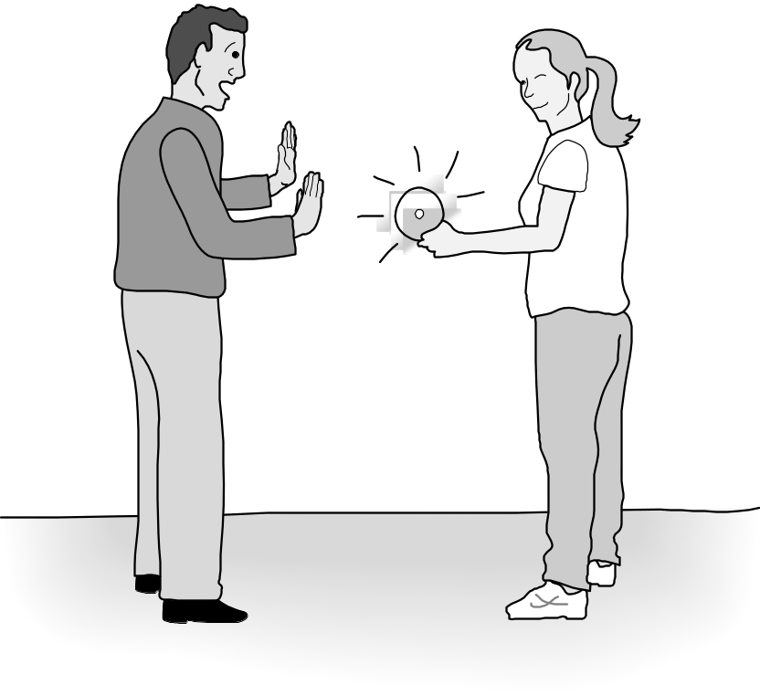
Clause 2.02
Don’t Use Software Obtained Illegally
9-18

Slide 30
Ensure Products Meet Highest Standards
3.01 Aim for “high quality, acceptable cost and a reasonable schedule,” making trade-offs clear
3.02 “Ensure proper and achievable goals”
3.03 Face up to “ethical, economic, cultural, legal and environmental” issues
3.04 Ensure you are qualified for proposed work
3.05 Use appropriate project methodologies
3.06 Follow the most appropriate professional standards
3.07 “Strive to fully understand the specifications”
3.08 Ensure the specifications are correct and approved
9-19

Slide 31
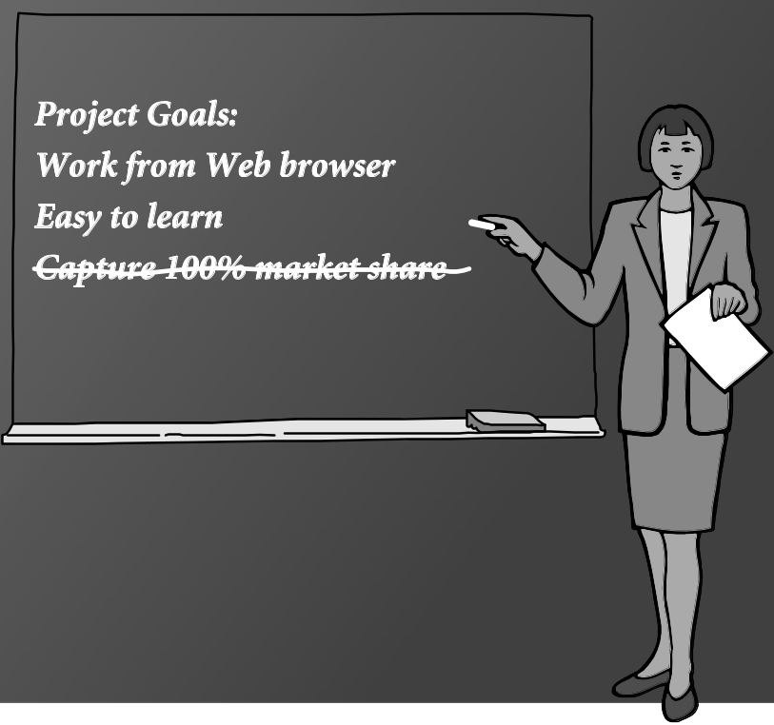
Clause 3.02
“Ensure Proper and Achievable Goals”
9-20

Slide 32
Ensure Products Meet Highest Standards
3.09 “Ensure realistic quantitative estimates of cost, scheduling, personnel, quality and outcomes”
3.10 “Ensure adequate testing, debugging, and review of software and related documents”
3.11 “Ensure adequate documentation”
3.12 Develop software and documents that respect privacy of those affected by software
3.13 Use only accurate data appropriately acquired
3.14 Maintain data integrity
3.15 Use same standards for software maintenance as software development
9-21

Slide 33
Maintain Integrity in Professional Judgment
4.01 “Temper all technical judgments by the need to support and maintain human values”
4.02 Understand and agree with documents before endorsing them
4.03 Remain objective when evaluating software or related documents
4.04 Do not engage in deceptive financial practices
4.05 Disclose conflicts of interest
4.06 Do not participate in decisions in which you, your employer, or your client has a potential conflict of interest
9-22

Slide 34
Promote Effective Project Management
5.01 Ensure good project management procedures
5.02 Ensure software engineers know standards
5.03 Ensure software engineers know policies and procedures for protecting confidential information
5.04 Take employees’ abilities into account before assigning work
5.05 Ensure reasonable estimates are made
5.06 Give full and accurate information to potential employees
9-23

Slide 35
Promote Effective Project Management
5.07 Pay employees fairly
5.08 Do not unjustly prevent a qualified person from taking a job
5.09 Work out fair intellectual property agreements
5.10 Provide employees charged with misconduct due process
5.11 Do not ask someone to do anything violating the Code
5.12 “Do not punish anyone for expressing ethical concerns about a project”
9-24

Slide 36
Advance the Profession
6.01 Help create an environment supporting ethical conduct
6.02 “Promote public knowledge of software engineering”
6.03 Participate in professional activities
6.04 Support others who are trying to follow this Code
6.05 Do not promote self-interest at expense of profession, client, or employer
6.06 Obey all laws unless there is an overriding public interest
6.07 Do not deceive others regarding the characteristics of software
9-25

Slide 37
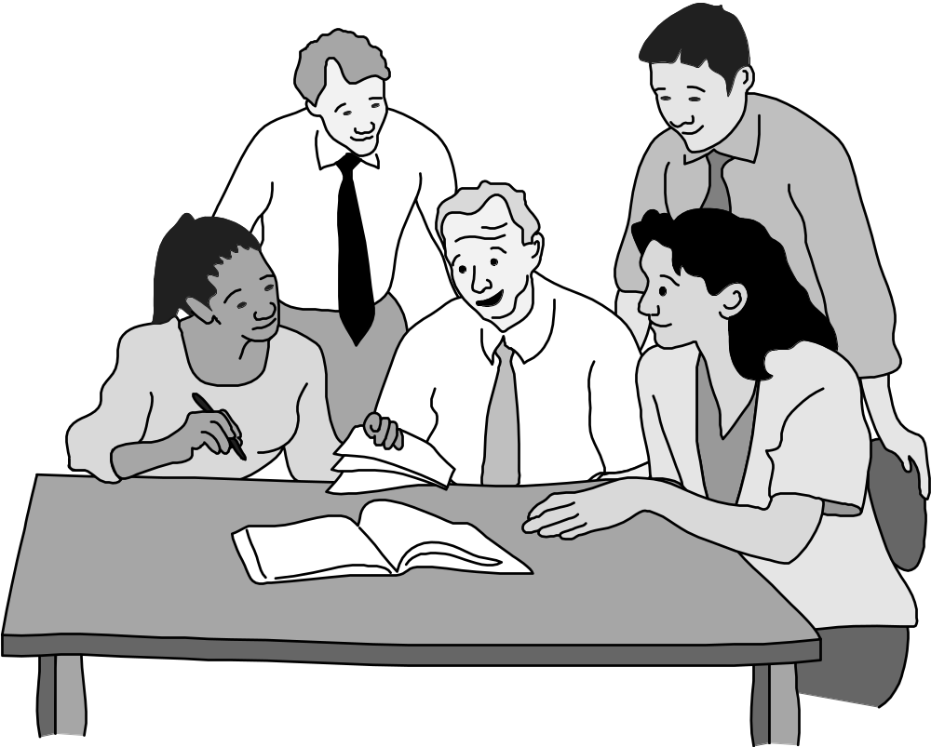
Clause 6.01 Help Create An Environment Supporting Ethical Conduct
9-26

Slide 38
Advance the Profession
6.08 Take responsibility for finding, correcting, and reporting errors in software and documentation
6.09 Ensure others know you are committed to the Code and what that means
6.10 Do not associate with businesses and organizations that are in conflict with Code
6.11 Understand violating the Code is inconsistent with being a professional
6.12 Share concerns about Code violations with the people involved
6.13 “Blow the whistle” when no alternative to reporting significant Code violations
9-27

Slide 39
Be Fair to and Supportive of Colleagues
7.01 “Encourage colleagues to adhere to this Code”
7.02 “Assist colleagues in professional development”
7.03 Give others the credit they deserve
7.04 Be objective when reviewing the work of others
7.05 Give colleagues a fair hearing
7.06 Help colleagues remain aware of work practices
7.07 Do not unfairly interfere with another’s career, but protect the public interest
7.08 Bring in experts for situations outside your own area of competence.
9-28

Slide 40
Participate in Lifelong Learning
8.01 Stay current with developments in field
8.02 Improve ability to create high quality software
8.03 Improve ability to produce high quality documentation
8.04 Improve understanding of software and documentation used in work
8.05 Improve knowledge of relevant standards
8.06 Improve knowledge of this Code and its application
8.07 Do not treat others unfairly because of prejudices
8.08 Do not influence others to break the Code
8.09 “Recognize that personal violations of this Code are inconsistent with being a professional software engineer”
9-29

Slide 41

Clause 8.02 Improve Ability to Create High Quality Software
9-30

Slide 42
9.4 Analysis of the Code
9-31

Slide 43
Analysis of Preamble
No mechanical process for determining if an action is right or wrong
Should not take an overly legalistic view of the Code
  If Code doesn’t forbid something, that doesn’t mean it is morally acceptable
  Judgment required
Code reflects principles drawn from multiple ethical theories
9-32

Slide 44
Alternative, Discipline-Independent List of Fundamental Principles
Be impartial.
Disclose information that others ought to know.
Respect the rights of others.
Treat others justly.
Take responsibility for your actions and inactions.
Take responsibility for the actions of those you supervise.
Maintain your integrity.
Continually improve your abilities.
Share your knowledge, expertise, and values.
9-33

Slide 45
9.5 Case Studies
9-34

Slide 46
Case: Software Recommendation
Sam Shaw asks for free advice on LAN security
Prof. Smith answers questions and recommends top-ranked package
Prof. Smith does not disclose
  She has financial interest in company producing top-ranked package
  Another package was given a “best buy” rating
Did Prof. Smith do anything wrong?
9-35

Slide 47
Analysis
Most relevant principles
  Be impartial.
  Disclose information others ought to know.
  Share your knowledge, expertise, and values.
Clause 1.06: Prof. Smith was deceptive
Clauses 1.08, 6.02: Prof. Smith freely gave valuable information
Clauses 4.05, 6.05: Prof. Smith did not reveal conflict of interest
9-36

Slide 48
Conclusion
Professor Smith should have revealed her conflict of interest to Mr. Shaw.
9-37

Slide 49
Case: Child Pornography
Joe Green a system administrator
Asked to install new software package on Chuck Dennis’s computer
Green not authorized to read other people’s emails or personal files
Green sees suspicious-looking file names
He opens some of Dennis’s files and discovers child pornography
What should he do?
9-38

Slide 50
Analysis (1/2)
Most relevant principles
  Be impartial
  Respect the rights of others
  Treat others justly
  Maintain your integrity
9-39

Slide 51
Analysis (2/2)
Most relevant clauses
  2.03: Somebody has misused the company PC
  2.09: Someone is using the PC for a purpose not in the employer’s interest
  3.13: Joe violated the policy against opening files
  5.10: Someone else may have planted the files on Chuck’s computer
9-40

Slide 52
Conclusions
Joe was wrong to violate company policy to uncover child pornography
Once he has this knowledge, however, he is obliged to share it with company authorities
Joe should be discreet
9-41

Slide 53
Case: Anti-Worm
Internet plagued by new worm that exploits hole in popular operating system
Tim Smart creates anti-worm that exploits same security hole
Tim’s anti-worm fixes PCs it infects. It also uses these PCs as launch pad to reach new PCs.
Tim launches anti-worm, taking pains to keep it from being traced back to him.
The anti-worm quickly spreads through Internet, infecting millions of computers
System administrators around the world combat the anti-worm
9-42

Slide 54
Analysis (1/2)
Most relevant principles
  Continually improve your abilities.
  Share your knowledge, expertise, and values.
  Respect the rights of others.
  Take responsibility for your actions and inactions.
9-43

Slide 55
Analysis (2/2)
Most relevant clauses:
  1.01: Tim did not accept responsibility for his action.
  1.08: The worm was free, but cost system administrators a lot of time.
  2.03: The anti-worm entered computers without permission of their owners.
  8.01, 8.02, 8.06: Tim improved his knowledge and skills by creating the anti-worm.
9-44

Slide 56
Conclusions
Tim’s welfare is less important than the public good
By attempting to hide his identity, Tim refused to accept responsibility for his actions
Tim violated the property rights of the PC owners whose systems were infected by his anti-worm
Tim violated the Code
9-45

Slide 57
Case: Consulting Opportunity
Jean works in support organization for Acme Corporation
Many Acme customers downgrading their level of support
East Dakota gives Jean opportunity to run a training class similar to that provided by Acme
Jean tells no one at Acme
Jean develops materials at home on own time
Jean takes paid vacation to teach class
9-46

Slide 58
Analysis (1/2)
Most relevant principles
  Be impartial.
  Take responsibility for your actions and inactions.
  Disclose information that others ought to know.
  Maintain your integrity.
  Continually improve your abilities.
9-47

Slide 59
Analysis (2/2)
Most relevant clauses
  3.04: Jean was well qualified to develop materials and teach class
  8.04: By creating materials, Jean became even more familiar with Acme’s package and its capabilities
  4.05: Jean didn’t disclose his conflict of interest with his employer
  2.08: Jean deprived himself of “time off” needed to do his best work at Acme
  6.05: Jean put his own interest above that of his employer
9-48

Slide 60
Conclusions
Jean did not disclose East Dakota’s offer or his decision to Acme’s management
Acme’s management is likely to question Jean’s loyalty to the company
Jean’s actions were wrong and unwise
9-49

Slide 61
9.6 Whistle-blowing
9-50

Slide 62
Overview of Whistle-blowing
Whistle-blower
  Tries to report harmful situation through authorized channels
  Rebuffed by organization
  Makes disclosure through unauthorized channels
Whistle-blowers punished for their actions
  Lose job or all chances of advancement
  Financial and emotional hardship
False Claims Act
Whistleblower Protection Act
9-51

Slide 63
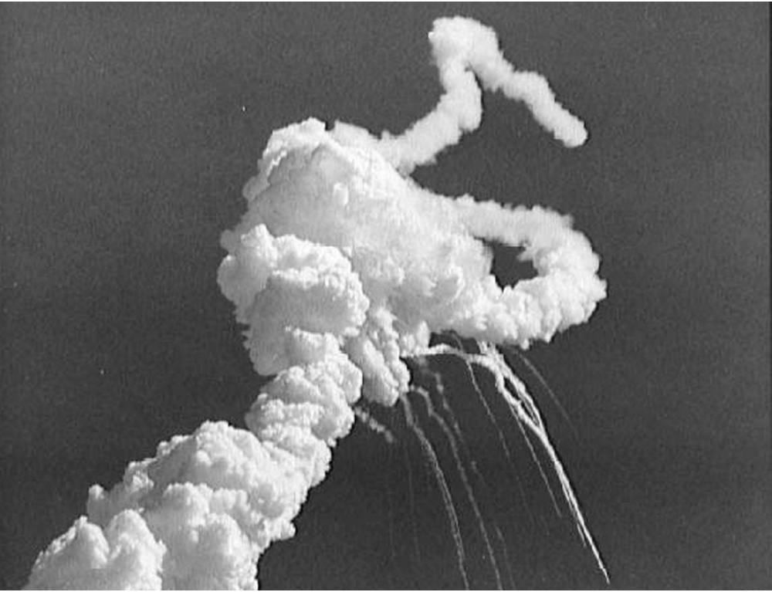
The Challenger Explosion Killed Seven Astronauts
Courtesy of NASA
9-52

Slide 64
Case: Morton Thiokol/NASA
Challenger explosion
Roger Boisjoly and Morton Thiokol engineers documented dangers of low-temperature launches
Morton Thiokol executives and NASA officials overrode and hid concerns
Boisjoly shared information with Presidential commission
Morton Thiokol retaliated
  Boisjoly took medical leave for stress, then quit
  Found job as a consultant two years later
9-53

Slide 65
Case: Hughes Aircraft
Factory for military-grade hybrid chips
Some defective chips being approved
Ruth Goodearl reported incidents to upper management
Consequences for Goodearl
  Harassed
  Fired
  Unemployment
  Bankruptcy
  Divorce
Goodearl and Ruth Aldred sued Hughes Aircraft under False Claims Act and won
9-54

Slide 66
Motives of Whistle-blowers
People become whistle-blowers for different reasons
Morality of action may depend on motives
Good motive
  Desire to help the public
Questionable motives
  Retaliation
  Avoiding punishment
9-55

Slide 67
Corporate Response to Whistle-blowing
Whistle-blowers are disloyal
Whistle-blowing has many harms
  Bad publicity
  Disruption of organization’s social fabric
  Makes it hard for people to work as team
If company causes harm, public can use legal remedies to seek damages
Critique: Overly legalistic view of public harm?
9-56

Slide 68
Whistle-blowing as Organizational Failure
Whistle-blowing harms organization
  Bad publicity
  Ruined careers
  Erodes team spirit
Whistle-blowing harms whistle-blower
  Retaliation
  Estrangement
Organizations should improve communication
Critique
  Is this realistic?
  Robert Spitzer: Organizations should return to using principle-based ethics in decision making
9-57

Slide 69
Whistle-blowing as Moral Duty
Richard DeGeorge’s questions for whistle-blowing
  Is serious harm to the public at stake?
  Have you told your manager?
  Have you tried every possible inside channel?
  Do you have persuasive documented evidence?
  Are you sure whistle-blowing will work?
Under what conditions must you blow the whistle?
  DeGeorge: If all five conditions are met
  Others: If conditions 1-3 are met
  Still others: Whistle-blowing is never morally required
9-58

Slide 70
Moral Responsibility
Exclusive Responsibilities
  Role responsibility
  Causal responsibility
  Legal responsibility
Moral responsibility
  Must be borne by people
  Is not exclusive
Michael McFarland: A team should be held to a higher level of moral responsibility than any of its members
9-59

